Slide 1


Slide 2
Fundamentals of Data Communications Network Analysis: Packet and Protocol Analyzers (Wireshark)
Levi Perigo, Ph.D.
University of Colorado Boulder
Department of Computer Science
Network Engineering

Slide 3
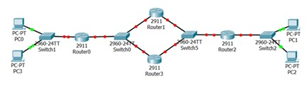
Review

Slide 4
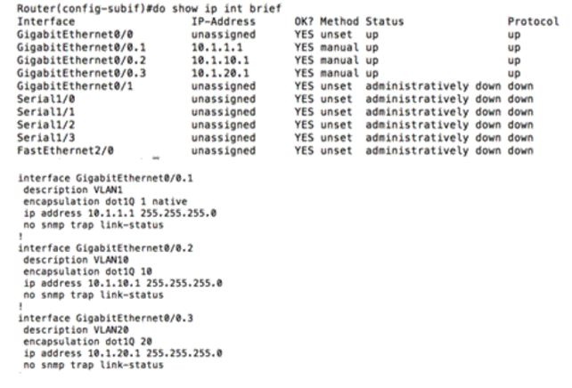
Notes:
Explain why a PC (IP Address 10.1.1.10) plugged into a switchport assigned in VLAN 10, is unable to trace route to any PCs.

Slide 5
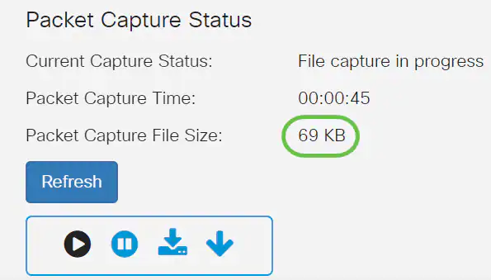
Packet Analysis
A packet analyzer or packet sniffer is a computer program (or hardware) that can intercept and log traffic that passes over a computer network or part of a network.
Packet capture is the process of intercepting and logging traffic
One of the most important tools for a network engineer!

Slide 6
Network Analysis
The process of listening to and analyzing network traffic
Passive and non-intrusive
Requires strong knowledge of network data flows
Switch, Router, Firewall
Requires strong knowledge of TCP/IP and protocol communications (IPv6, UDP, ICMP, DHCP, etc.)
Know the technology, figure out what’s wrong

Slide 7
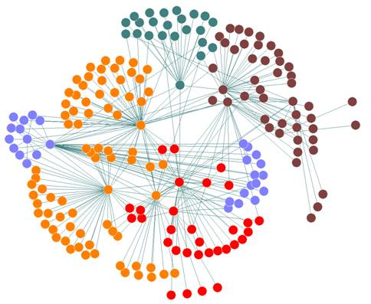
Purpose of Network Analysis
Troubleshooting
Security
Network Optimization
Application Analysis

Slide 8
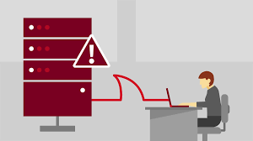
Troubleshooting Tasks
Locate faulty network devices
Identify device or software misconfigurations
DNS, DHCP, Rogue Access Point, IPSec
Measure high delays along a path
Latency via “time” field
Server TCP SYN/ACK/RST and Slowstart

Slide 9
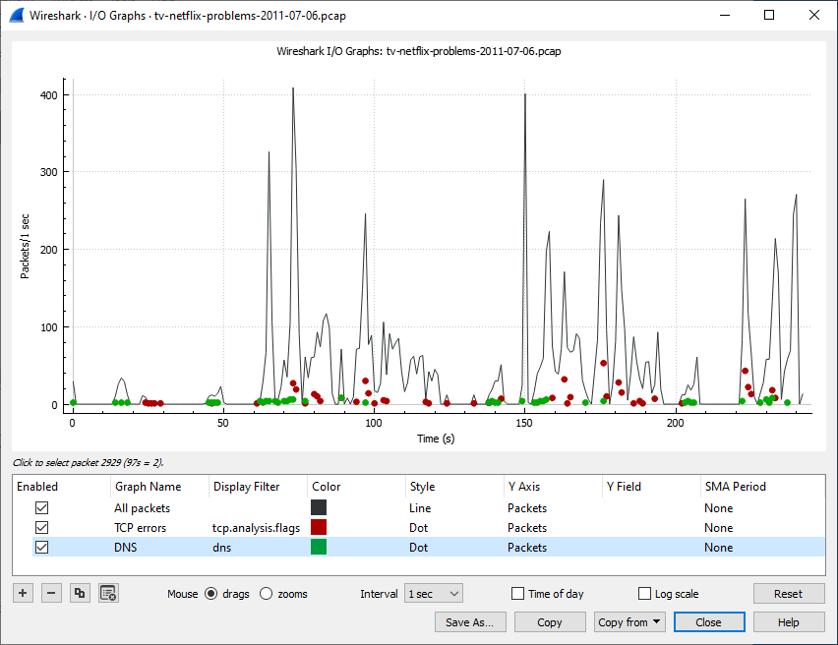
Troubleshooting Tasks Cont.
Locate the point of packet loss
Almost always hardware device
Identify network errors and service refusals
Graph queuing delays

Slide 10
Security Tasks
Perform intrusion detection (IDS)
Packets match filter
Can we perform IPS? What’s the difference?
Identify and define malicious traffic signatures
Passively discover hosts, OS, and services
Where would we place analyzer?

Slide 11

Security Tasks Cont.
Log traffic for forensics examination
Hash files (capinfos)
Capture traffic as evidence
Test firewall blocking
Outside and inside (make it through?)
Validate secure login and data traversal
Is traffic encrypted as it should?

Slide 12

Legal Issues of Listening to Network Traffic (Telecom Policy)
ECPA (Electronic Communications and Privacy Act) “Wiretap Act”
Prohibits the intentional, actual, or attempted interception, use…electronic communication
Security Issues to Consider
Define policies regarding use of a traffic capture tool
Secure files containing network traffic
PII (Personally Identifiable Information)
HIPPA & CMI
Protect against unwanted sniffers
Block ports
Wireless passwords
Top 5 recommendations

Slide 13
Network Optimization Tasks
Analyze current bandwidth usage
Evaluate efficient use of packet sizes in data transfer applications
Evaluate response times across a network
Troubleshooting the time between TCP SYN/SYNACK
Validate proper system configurations
How? Why?

Slide 14
Application Analysis
Why are applications important to the network?
Analyze application bandwidth requirements
Get a general summary of bandwidth usage and requirements
Ports? Time of day?
Identify application protocols and ports in use
Validate secure application data traversal

Slide 15
Analysis Review - Checklist
Find the top talkers
Allocate bandwidth appropriately
Identify the protocols and applications used on the network
Security – IDS
Baseline
Determine the throughput of applications or network traffic on a link
Web server, FTP, Mail, etc.
List all hosts communicating on link
Hosts you don’t recognize or abnormal?
Learn the most common connection problems
Latency and delays

Slide 16

Analysis Review - Checklist Cont.
Identify and locate misconfigured hosts - How?
DHCP
DNS
Gateway
Recognize segment/network or host that is slowing down traffic
Top Talkers
What do you do?
Locate asymmetric traffic prioritization
Graph HTTP flows
Examine website rates
Identify errors for specific protocol (HTTP, SIP, FTP, etc.)
Build graphs to compare traffic: good, normal, poor

Slide 17
Analysis Review - Checklist Cont.
Identify applications that do not encrypt traffic
Detect and analyze OS use on network
Replay VoIP conversations to listen to quality
VoIP Lab
What else could you do with this information?

Slide 18
Understand Network Traffic Flows
Switch
Layer 2 device
MAC addresses
Collision domain
Can’t tell if it has gone through switch (transparent)
Router
Layer 3 device
IP addresses
Broadcast domain
MAC
TTL
Firewall, Proxy, NAT/PAT
Proxy = Layer 4
PAT = Layer 3 and ”4”
IP address modifications

Slide 19
OSI Model Review
Application
Presentation
Session
Transport
Network
Data Link
Physical

Slide 20

What is Wireshark?
Packet and Protocol Analyzer
Analyzing Traffic
Troubleshooting Tasks
Security Analysis
Application Analysis
Rated the #1 Open-Source App of all time
#1 Network Protocol Analyzer
#1 Network Security Tool

Slide 21

Wireshark
Typical Uses
First responder tool!
Determine Bugs – How?
Top Talkers
Slow Response Times and Delayed Traffic
Network Traffic
**What is on the wire!
Name changed from Ethereal to Wireshark in 2006 for copyright reasons.
Certification – Wireshark Certified Network Analyst (WCNA) (not recommended)

Slide 22
How to get it?
You can download for computer FREE at www.wireshark.org.
All Wireshark files are .pcap or .pcapng
TShark = .pcapng
What version to get?
Upgrade occasionally
Stick with what works
Help
ask.wireshark.org

Slide 23
Why Wireshark?
Persistent
Remote/Left on Site
Standardization
Anyone can read Wireshark
Vendor specific logs/debugs
Logs/Debugs vs. .pcap
Logs can be misleading, or they do not capture the whole story
Debugs can be wrong
Why?
.pcap = packets do not lie!

Slide 24
Wireshark Elements
Capturing Traffic
Drivers
NIC – Wireless – Open File
Capture Filters
Use Sparingly
Example: Only capture DNS traffic
Can’t get that traffic back!
Use Display Filters instead of Capture Filters
Wiretap library
Can open almost any file (not only .pcap)
Capture Engine
Capture Filters
WinPcap – AirPcap libcap
Network

Slide 25
Processing Packets
Graphical Toolkit (GTK)
Core Engine
(Dissectors/Plugins – Display Filters)
Capture Engine
Wiretap Library

Slide 26
Place the Analyzer Appropriately
Placement is Key!
General Rule / Best Practice
Place Analyzer as close to the complaining user/suspecting unit as possible – Why?
See from the client’s perspective
If errors coming from server; then move or add another analyzer to the sever location
Multiple Locations
(Problems with this?)

Slide 27
Where to implement it?
Depends on the problem and the network configuration
If you suspect or know that between the client and the server there are some devices that can ‘’mangle’’ the network communications (NAT/Websense appliances, IPSec, firewalls, etc.)
Capture in multiple places

Slide 28
Capture Appropriate Traffic
Where do we place it?
Connecting Analyzer to Switches
Forward based on target MAC address; doesn’t reach analyzer
Analyzer Receives Four Types of Traffic
Broadcast
Multicast (if configured to pass MCAST)
Unknown MAC
Analyzer MAC
Notes:
Where to we place it? First, have the class draw/explain where to place the analyzer and then have them explain the packet flow until they realize the traffic doesn’t reach the analyzer.

Slide 29
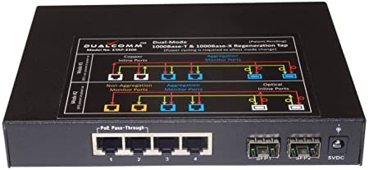
Capture Appropriate Traffic - Options
Install on host machine
Security Issues
Individual
Unavailable
May be unreliable
CPU Usage
Tap Device
Port Span/Port Mirror
Switch Capable
Administrator Capable
Install Hub
Half-duplex
Move Device to Hub too!

Slide 30
Capture Appropriate Traffic
What about a wireless network?
Promiscuous and/or Monitor Mode
All traffic
Need to see Control and Management Frames
Physically stand by the person/device
Stand by AP (if all users)
WISpy adapter and/or AirPCAP adapters

Slide 31
Wireshark - Tips and Tricks
Display Filters
Statistics
Coloring Rules
Filter, Graph, Analyze

Slide 32
Display Filters
Error Detection = Green vs. Red
Keep Typing example:
ip.addr==255.255.2 (not green) ip.addr==255.255.255.255 (green)
Just because it is a valid filter doesn’t mean it is appropriate
Example: HTTP vs. HTTPS

Slide 33
Display Filters Cont.
Right Click is Easy Method
Note: Not Selected is Good Option
Apply vs. Prepare
Apply - takes affect immediately
Prepare - enters syntax to be changed/modified if needed
HTTP Errors are 399 and above
http.response.code == 404 change to http.response.code > 399

Slide 34
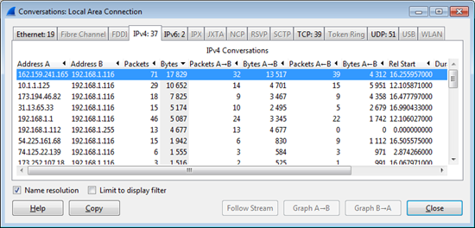
Stats
Statistics
Top Talker
Statistics > Conversations > Bytes > Apply as Filter
Statistics > Endpoints > IPv4 TX bytes > Apply as Filter

Slide 35
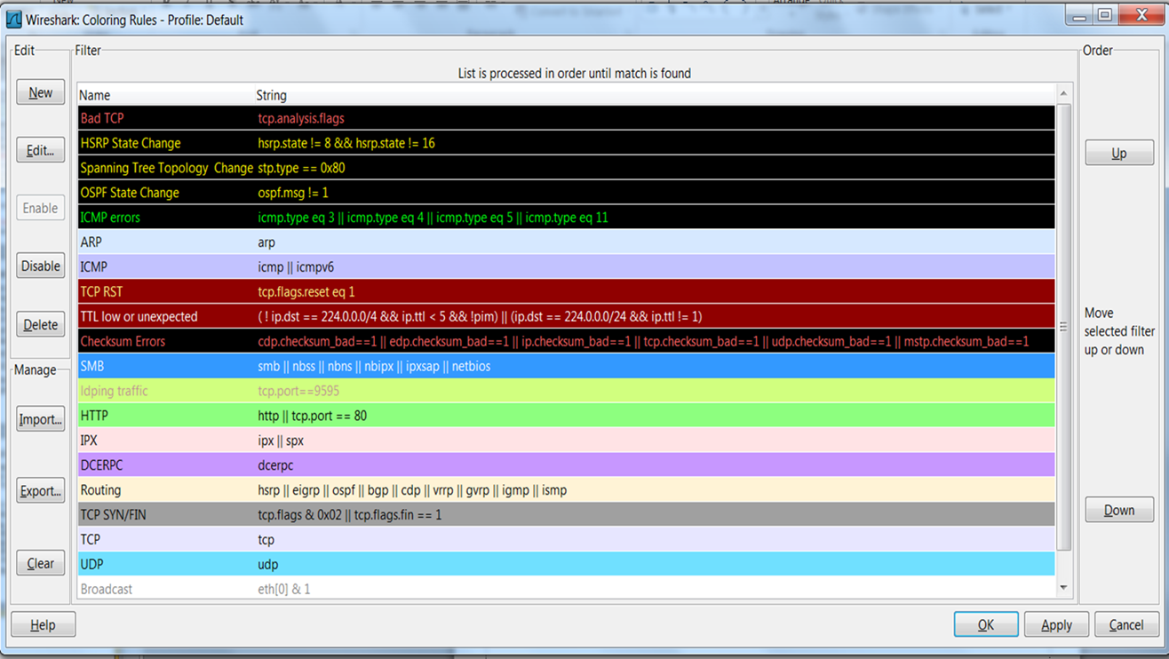
Coloring Rules
Great to add to different Profiles
Note: Work in “Top Down” fashion, similar to ACLs

Slide 36
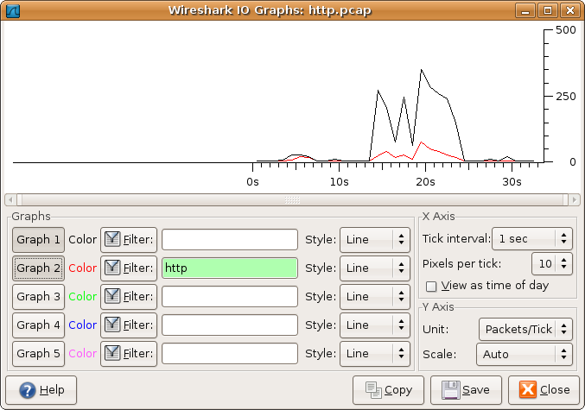
Filter, Graph, and Analyze Traffic
Expert Info Window
Button in Bottom Left = Gray vs. Yellow
Click on Yellow Button; then focus on errors
Details and Charts are rarely used
Charts and Graphs
Security
What protocols clients are using?
Statistics > Protocol Hierarchy
Statistics > Conversations
Check box for Limit to Display Filter
Graphs
Statistics > IO Graphs
Maps throughput download in graph format
Can alter multiple graphs overlapping to see when/why throughput drops
Statistics > TCP Steam Graph > Throughput Graph
Must contain data in packet
Statistics > TCP Steam Graph > Round Trip Time Graph
Statistics > HTTP > Requests

Slide 37


CLI Access
Terminal-based Wireshark
TShark
TCPDump
Notes:
What are the benefits: pro/con?
No remote access, but CLI access
Faster
Advanced filters
Automation and logging and self-healing

Slide 38

The “Needle in the Haystack” Issue
The #1 reason network engineers shy away from analysis tools
Capture close to client first
Rarely use capture filters
Okay if you are in the middle of the enterprise – Why?
Use display filters to exclude “good” traffic or focus on “bad” traffic
Colorize “bad” or “questionable” traffic
Add filter expression buttons or specific profiles to quickly find network problems
Lab
Reassemble for clarity/easy understanding
“Follow the stream”
Graph for visibility

Slide 39
Troubleshooting
Notes:
Can’t access facebook.com
Incorrect DNS
DNS is down
Wrong default-gateway
Cable unplugged
Gateway router doesn’t have a DR
Sending traffic to Internet, but not getting anything back
Firewall is blocking that URL

Slide 40
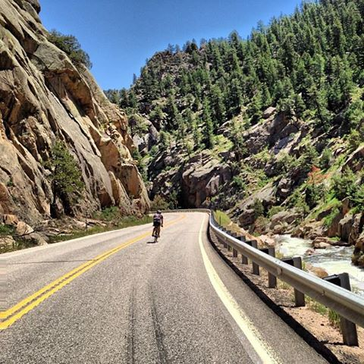
Questions?

Slide 41
References
Chappell University
Chapell, L. (2013) Wireshark 101

Slide 42
Appendix

Slide 43
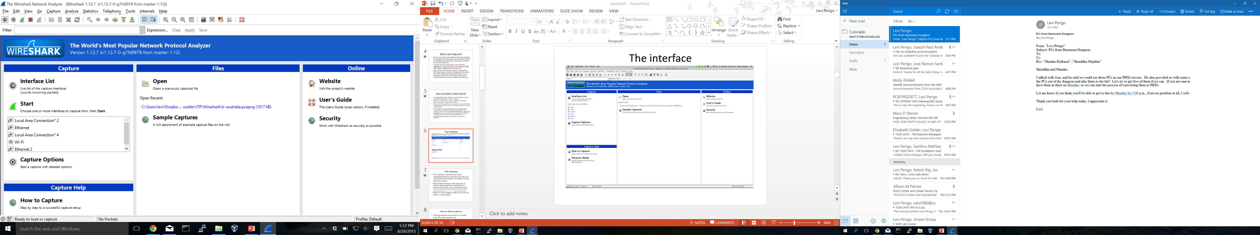
The Interface

Slide 44
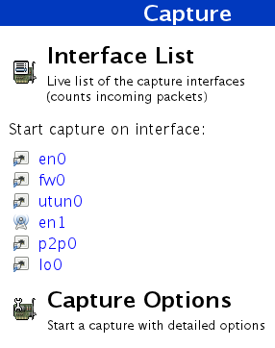
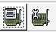
How to start a capture
Starting a capture can be done in multiple ways. The most common are:
Select an interface from the interface list: the capture begins immediately with the default option
Click on the Interface List
Click on the one of the two first icons of the ribbon

Slide 45
How to start a capture
Press Ctrl+E
Use the Capture menu
When you start a capture you can generally choose some options (except when you press CTRL+E or click directly on the interface: In these cases the capture starts immediately).
The most important options you need to know in the option pane are: promiscuous mode, capture filter & enable network name resolution.
CAVEAT: use the enable network name resolution option sparingly! This option will generate a lot of DNS requests and so DNS replies as well. You may not want to generate this kind of traffic.

Slide 46
Promiscuous mode or not?
In Promiscuous Mode your network interface is going to receive all the traffic even if it is not directed specifically to it. Example: a device (IP 10.14.8.1) is trying to talk with another device (IP 10.14.8.2) on the same network segment. If you are in Promiscuous Mode you should be able to see the conversation even if it is not for you.
There are many factors that may limit your visibility while you are in Promiscuous Mode such as network switches! If your switch is a ‘’proper one’’ should direct the traffic from device A to device B to the switch ports where A and B are physically plugged in.
There are some solutions to this problem: configure the switch to repeat all the traffic to a SPAN port, use an HUB to connect the devices (if you are still able to find one) or ask budget to buy an Aggregating Network TAP)
If you are not in Promiscuous Mode you will be able to see all the traffic direct to you, broadcast and multicast traffic.

Slide 47
Capture Filters
Some Common and Capture Filters:
ip | Only IP traffic
tcp | Only TCP traffic
udp | Only UDP traffic
host 192.168.0.1 | All the traffic to/for 192.168.0.1
not broadcast and not multicast | Self explanatory
ether src 10:10:EA:11:33:22 | All the Ethernet traffic from that MAC address
ether dst 10:10:EA:11:33:22 | All the Ethernet traffic to that MAC address
ether host 10:10:EA:11:33:22 | All the Ethernet traffic to/for that MAC address
port 80 | Udp or Tcp traffic where the source or destination port is the 80
tcp and udp | Only TCP and UDP traffic

Slide 48
Display Filters
Display filters: their knowledge is essential to analyze the traffic. They help us to display only the interesting traffic and solve the famous ‘’needle in the haystack” problem
They can be applied while you are capturing or after the capture is finished.
Their syntax is used for Columns definition and coloring rules as well.
Wireshark comes already with a predefined list of filters that can be used as example (starting point)
Display Filters as the Capture Filters are case sensitive ! HTTP is not the same of http
Fortunately when you type filters in the filter field you can use Intellisense.

Slide 49
Display Filters
To create a filter you can simply type it in the filter field and get the advantage of Intellisense.
Another way to create a filter is to explode a packet in the details section, click on a particular section of it, then right click and choose Prepare Filter or Apply filter.
The difference between apply and prepare is that Apply will immediately apply the filter instead prepare will only prepare the filter in the filter field and then you will need to press the Apply button. The advantage is that you can have a look to the syntax generated and eventually amend it before to apply it.
Another way is to press the Expression button that’s near the Filter field: a GUI to help you to formulate the expression will appear.

Slide 50
Display Filters
But what about if I want to filter a certain field but I do not know its name?
The simplest way is to explode the packet and select the field in the Packet Display section and have a look to the Status Bar.
In this case we selected the Do not fragment field and its syntax is ip.flags.df == 1 (1 is set , 0 is not)

Slide 51
The general structure of a display filter is a sequence of expressions eventually concatenated by logic operators. An expression is a field + comparison operator + value. Example: tcp.dstport == 80
The most common comparison operators are: ==, ||, &&, >=, !=, <=, >, <, matches, contain. For the nostalgic geek it is possible to use the literals eq, or, and, ge, ne,le,gt,lt
&& and || are logic operators
An example: tcp.port == 80 || tcp.port == 443
As with the display filter we need to be careful of the meaning of them
For example tcp && arp is a syntactically valid filter but, won’t match any traffic
Some popular protocols define some basic filters that help us to speed up the writing of filters.
For example instead of writing: tcp.port == 53 || udp.port == 53 we can simply write: dns
Instead of tcp.port==80 ||tcp.port == 443 we can write: http
Other popular protocols are: arp, bootp, smtp, pop3, smb, ftp, ftp-data, ldap, icmp, imap

Slide 52
Advanced Filters
In some special circumstances we need to match one or more bytes of a packet in specific positions. This type of filter is called offset filter and it is in this form: field (or protocol layer)[offset 0 based:length] comparison value
Example: eth.src[4:2]==22:1f
Example: ip[14:2] == 90:20
To formulate this kind of filter you need to know the protocol well and know what you are looking for.

Slide 53
Coloring Rules
Coloring Rules and Columns: they are defined with the same syntax used for Display Filters.
Have you noticed in captures that some packets have a different color from the others?
The Coloring Rules are a very import tool that will help you to better understand the trace file: you will be able to display different kind of packets in a different color and this will help you a lot to find the “needle in the haystack.”
You can manage them via the View -> Coloring Rules menu

Slide 54
Coloring Rules
Coloring rules color a packet if the rule, expressed with Display Filter syntax, is matched.
Coloring rules can be created, deleted, moved up and down, disabled, imported, exported or reset to default (Cleared).
Coloring rules are saved in the colorfilters file.
Rule precedence: the rules are evaluated from the top to the bottom of the list. When a rule is matched the evaluation finishes for that packet.
How to disable one: Checksum errors*(Most of the time this a false positive error caused by TCP/UDP offloading settings of your network adapter)
To disable it simply select it and then press the disable button. A line will appear on it marking that the rule is disabled. (It is better to disable rules than delete them)

Slide 55
Columns
Columns are fundamental to view the traffic you captured.
The default column set is not always appropriate for the analysis of all the problems you want to analyse.
So it is possible to define custom columns, resize them and re-arrange them as you like.
Clicking on a column you can sort the data in ascending and descending order: this feature is particularly useful when you order the capture for “Seconds since previous captured/displayed packet”
Custom Column definition needs the field name you want to display: the same field name you use in the Display Filter syntax.

Slide 56
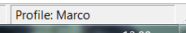
Creating a New Column
There are many ways to create a custom column: -Edit -> Preferences -> Column section. -Right click on a column and select Column Preferences. -Right click on a field and choose the option Apply as a column: in this case the column definition is applied immediately. If the column definition created is not what you want you will need to edit or remove it using the Column Preferences menu
Column definition is saved in your current profile directory in the preferences file(the active profile is displayed in the right down corner of Wireshark Window)

Slide 57

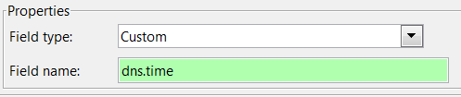

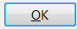
Define a Custom Column
Example create a new custom column:
Click on Edit -> Preferences -> Column section.
Click the button.
Select Custom from the Field Type drop down
Enter the field that you want to display in the column in the “Field name” field
Click on the title of the column and name it, then press and then

Slide 58
Useful Columns to Add
The columns you add depend on the traffic you are going to analyse. You may want to create different configuration profiles for different situations and define a different column set in every profile.
You can reposition the columns, delete them or simply hide them.

